Slide 1

Project 1
Zizhuo Tian

Slide 2

Problem 1
Use Stat package (stats.skew(data), stats.kurtosis(data))
skewness： - 0.17526772024433832
kurtosis： - 0.1554047077420786
Our function (unbiased)
$$Skewness= E\left[{\left(\frac{X−μ}{σ}\right)}^{3}\right], kurtosis=E\left[{\left(\frac{X−μ}{σ}\right)}^{4}\right]−3$$
skewness： - 0.17264528797569992
kurtosis： - 0.21201215405801133

Slide 3
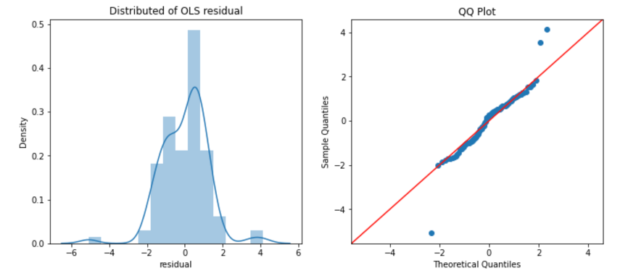
Problem 2
Fit data using OLS (use package statsmodels.formula )
Exist deviation

Slide 4
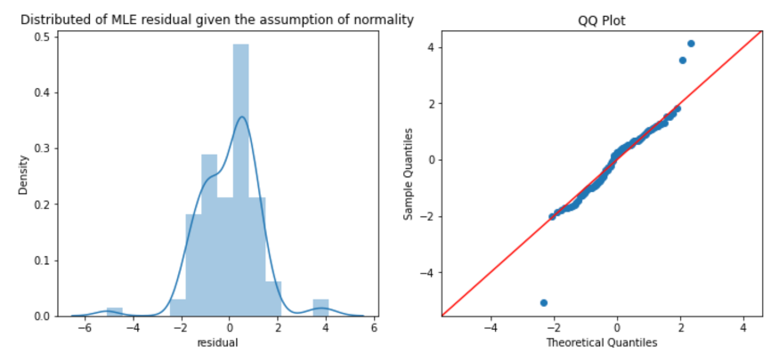
Problem 2
Fit data using MLE given assumption of normality
Exist deviation

Slide 5
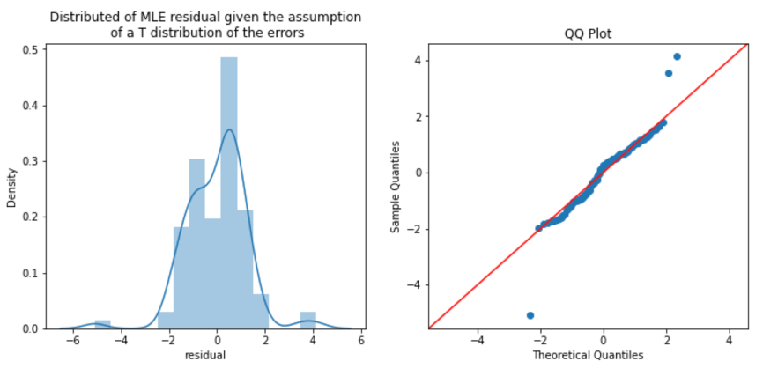
Problem 2
Fit data using MLE given assumption of a T distribution of the errors
Exist deviation

Slide 6
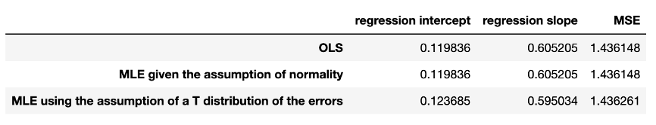
Problem 2
Summary
The regression parameters and MSE are the same
Fit the MLE using the assumption of a T distribution of the errors has the highest MSE and is the worst fitting method.
All three methods are breaking of the normality assumption in regards to expected values in this case, which means that the prediction results of the model are not accurate enough, there may be potential model bias, or the assumption of the model may be incorrect.

Slide 7
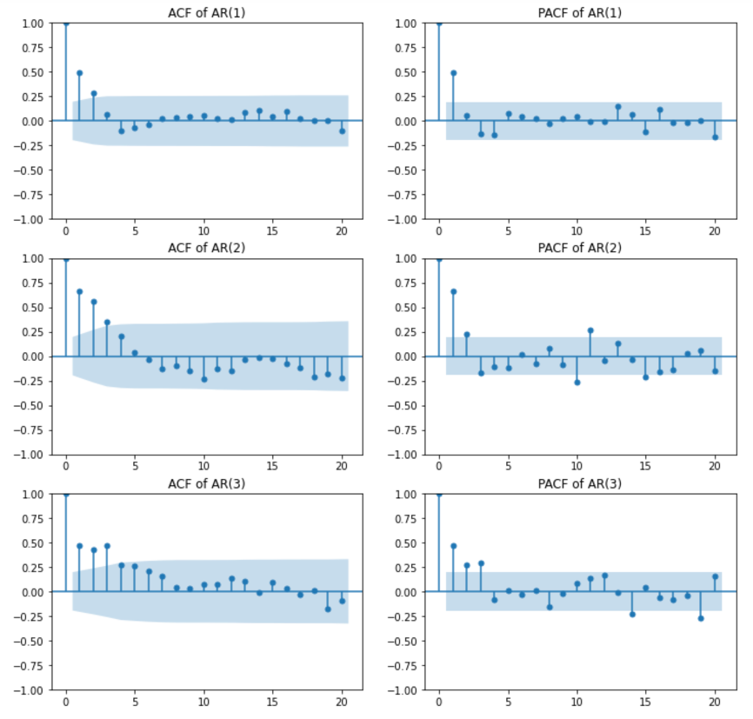
Problem 3
AR
ACF graph shows an exponential decay
PACF graph shows a sharp cut-off after the order of the process
For example:
ACF graph for AR(2) process shows an exponential decay, with the lag- 1 and lag-2 autocorrelation coefficients being the highest.
PACF graph shows a sharp cut-off after lag-2, indicating that only the lag-1 and lag-2 autocorrelations are significant.

Slide 8
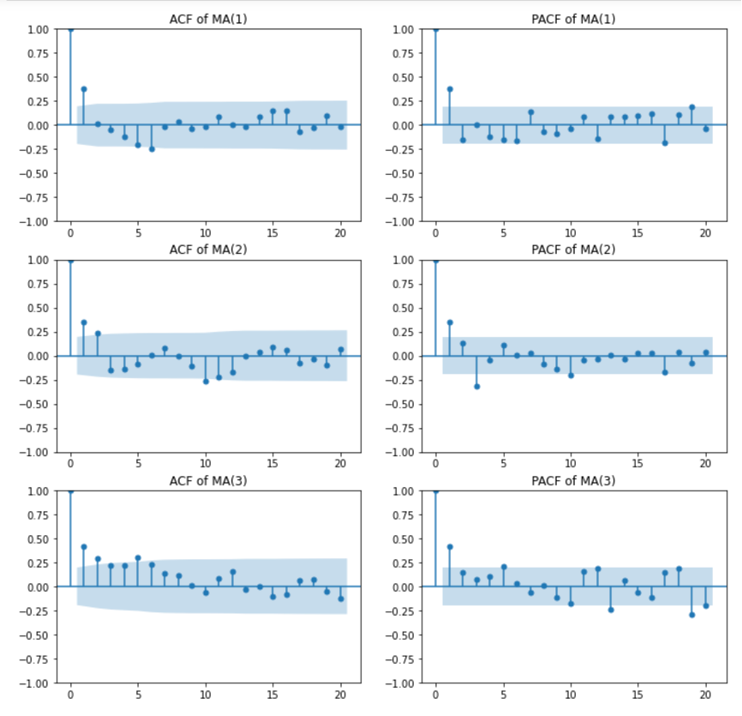
Problem 3
MA
ACF graph shows a sharp cut-off after the order of the process
PACF graph shows an exponential decay
For example:
ACF graph for MA(2) process shows a sharp cut-off after lag-2, indicating that only the lag-1 and lag-2 autocorrelations are significant
PACF graph shows an exponential decay, with the lag- 1 autocorrelation coefficient being the highest.

